Slide 1
All work and no play makes for unhappy nations
By: Adriana van de Guchte, Jeremy Brent,
Kasia Kalemba, Matteo Bommarito

Slide 2
Motivation
Coronavirus has changed the relationship of nearly all individuals to how they work
We have personally noticed a change in working hours, either working more or less, we wanted to understand the relationship between working hours and different metrics of success
What effect does work play in the lives of individuals and the economic success of nations?
Notes:
JB Work- Brainstorming
How can we make this story? What story is our data telling us and how can we connect it to current events
Our lives have fundamentally changed since the Coronavirus
We know, anecdotally, that many jobs have gone remote (can we find this stat).
Unemployment rate has increased from 3.5% in February of this year to 4.4% in March; Unemployment rate has increased .9% from February 2020 to March 2020 (https://www.bls.gov/news.release/pdf/empsit.pdf Summary Table A).
Quick note, working hours has not changed (Summary Table B)
“LinkedIn data shows a 42% leap in the March 1 to March 31 volume of job searches involving the keywords “remote” or “work at home.”” (https://www.linkedin.com/pulse/goodbye-office-remote-jobs-surge-28-march-george-anders/)
We know that the location of the work environment is shifting while working hours are not.
We wanted to understand potential relationships between hours worked and metrics of well-being (alcohol consumed, self-reported happiness scores, life satisfaction) and macroeconomics (GDP, productivity) globally.

Slide 3
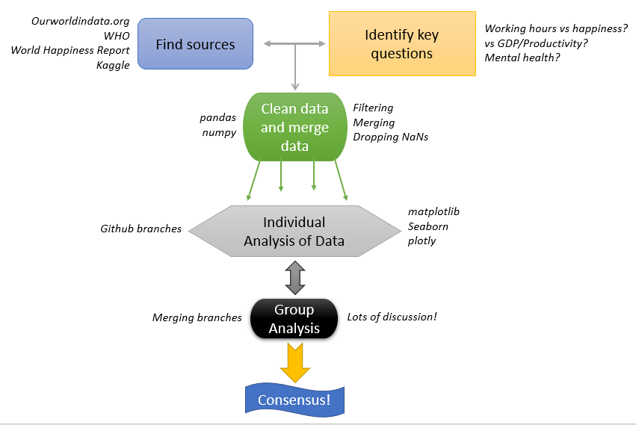
Workflow
Notes:
Work flow =
Find sources -> list sources -> develop questions -clean data using pandas and numpy, -> list some methods of cleaning - > merge data -> individual analysis for unbiased results -> mention major modules -> group analysis of results -> branch merging -> final consensus

Slide 4
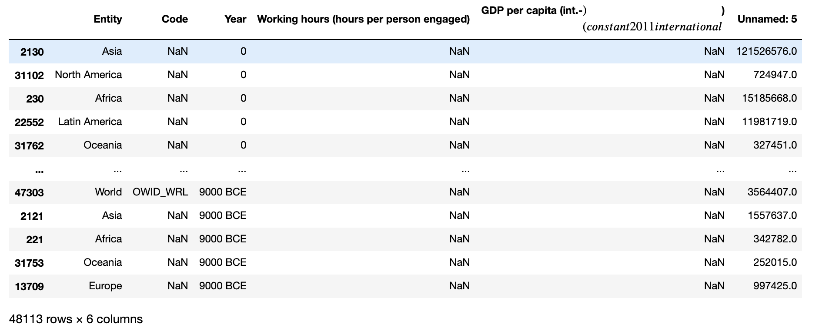
Data Wrangling
Not all data sets had continuous years
We experienced some crazy issues...
Unnamed columns, 10000 BCE

Slide 5
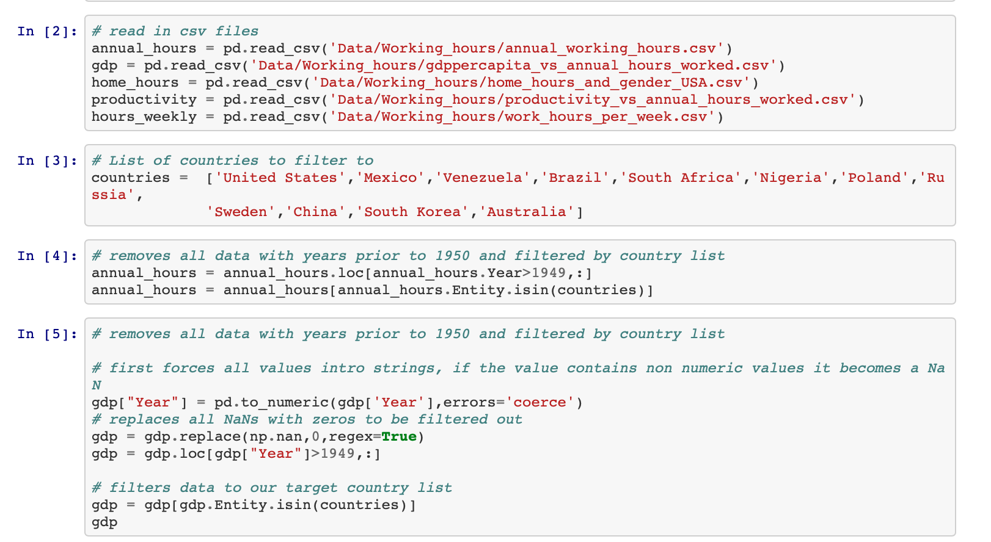
Example of Cleaning:
Filter by country
Filter by years
Convert objects to numeric data
Replace NaNs

Slide 6
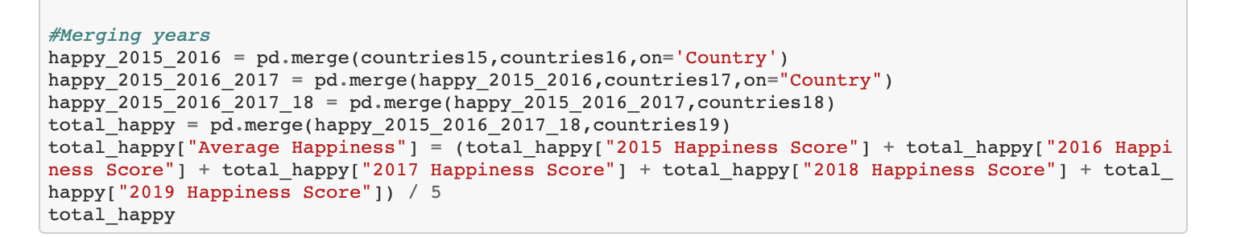
Example of Data Merging:
Single Column Merge for 2 DF
Double Column Merge
For 2 DF
Multiple DF Merge

Slide 7
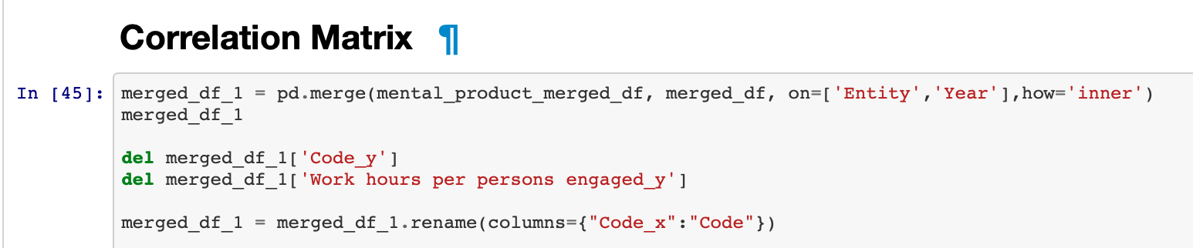
Example of Issues:
(Jeremy - don’t forget to restart your Kernel)

Slide 8
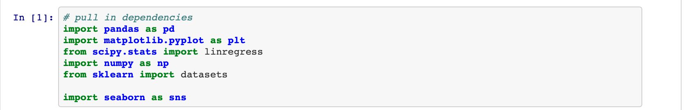
Example of Tools Used:

Slide 9
Aims
Aim 1: Have annual working hours changed over time?
Aim 2: What is the relationship of work hours to happiness?
Aim 3: Do people who work more have more substance abuse issues? Drink more?
Aim 4: What is the relationship between working hours and productivity? GDP?

Slide 10
Aims
Aim 1: Have annual working hours changed over time?
Aim 2: What is the relationship of work hours to happiness?
Aim 3: Do people who work more have more substance abuse issues? Drink more?
Aim 4: What is the relationship between working hours and productivity? GDP?

Slide 11
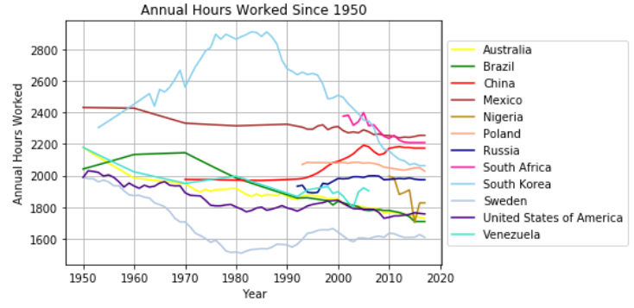
Aim 1: Changes in annual working hours

Slide 12
Aims
Aim 1: Have annual working hours changed over time?
Primarily trending downwards
Aim 2: What is the relationship of work hours to happiness?
Aim 3: Do people who work more have more substance abuse issues? Drink more?
Aim 4: What is the relationship to productivity? GDP?

Slide 13
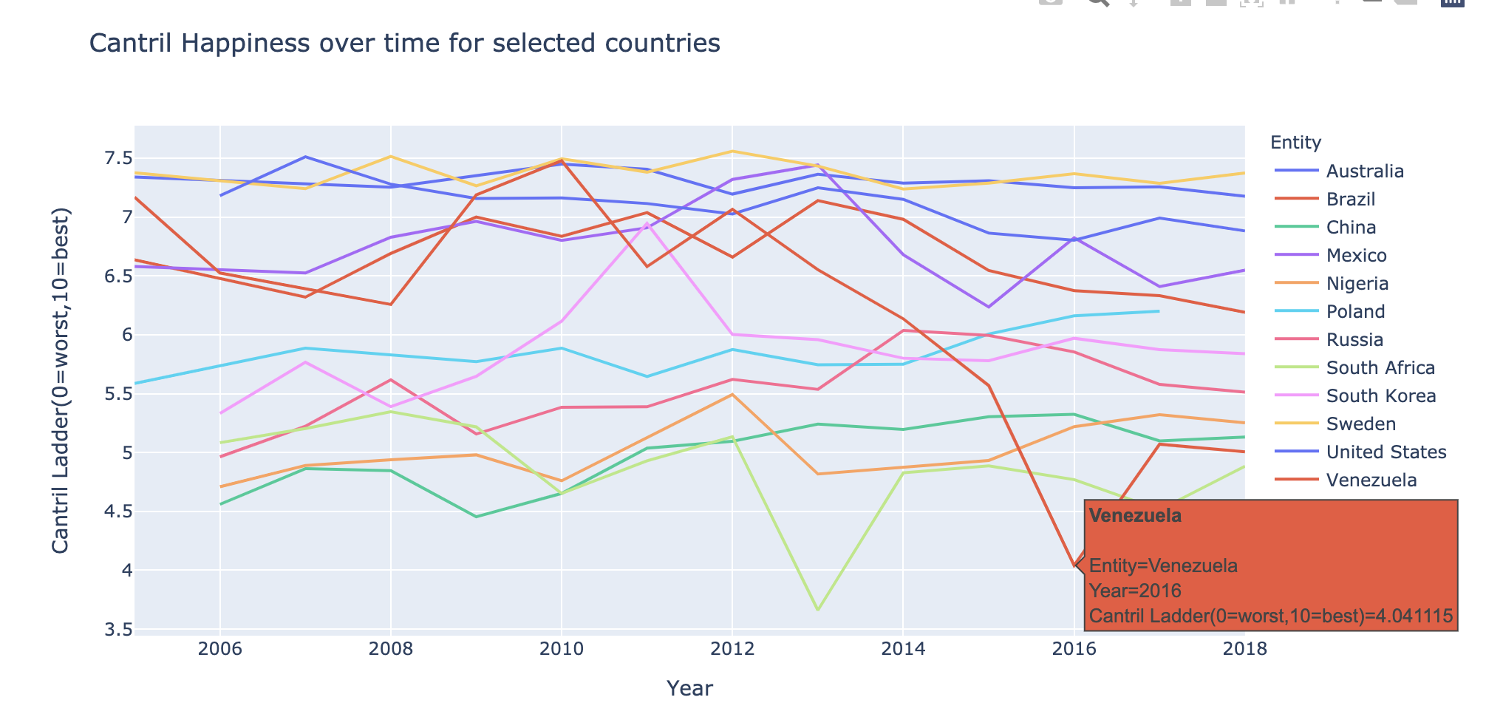
Aim 2: How has happiness changed over time?

Slide 14
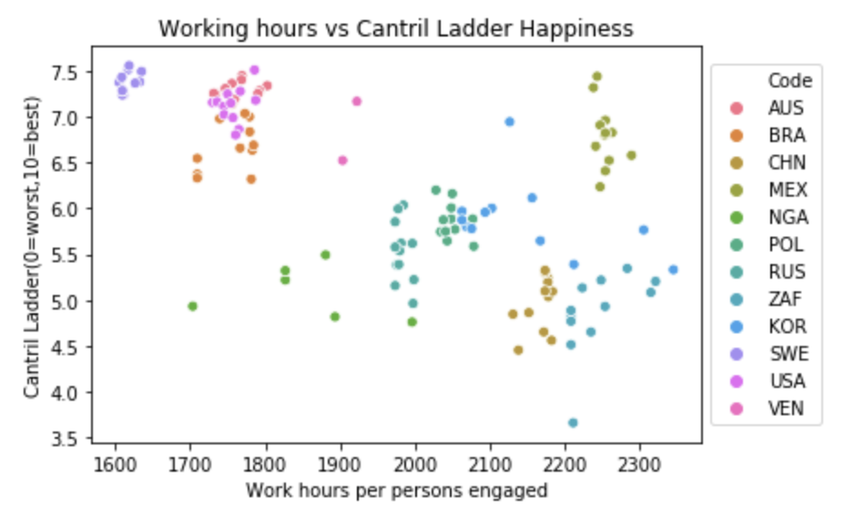
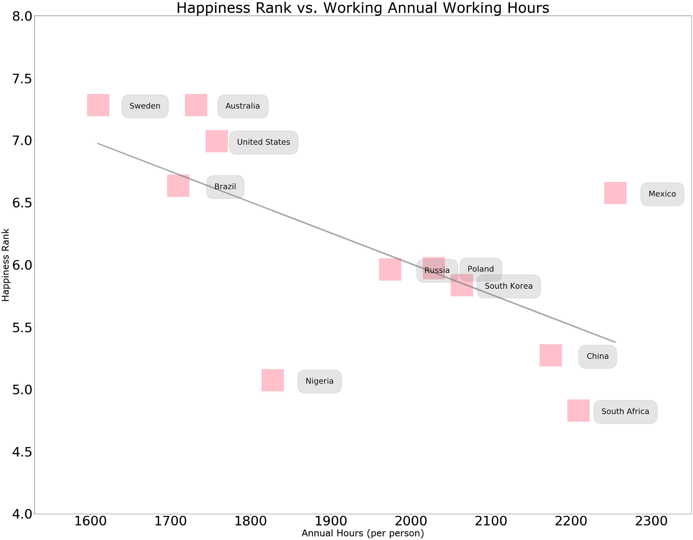
Aim 2: Are we less happy when we work more?
B
2017
A
The r-squared is: 0.40
Notes:
https://www.visualcapitalist.com/shorter-workweek-make-people-happier/

Slide 15
Aims
Aim 1: Have annual working hours changed over time?
Primarily trending downwards
Aim 2: What is the relationship of working hours to happiness?
Changes in happiness over time seems to be nation dependant.
People who work more tend to be less happy!
Aim 3: Do people who work more have more substance abuse issues? Drink more?
Aim 4: What is the relationship to productivity? GDP?

Slide 16
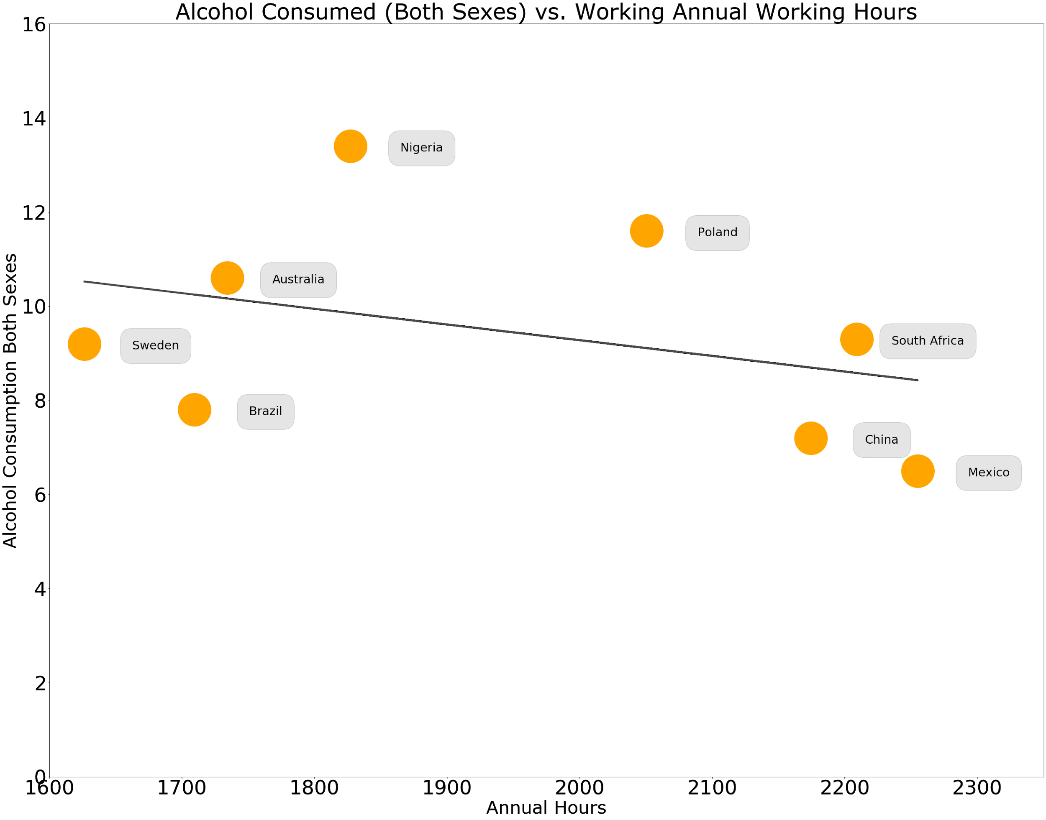

Aim 3: Do nations that work more drink more?
The r-squared is: 0.12

Slide 17


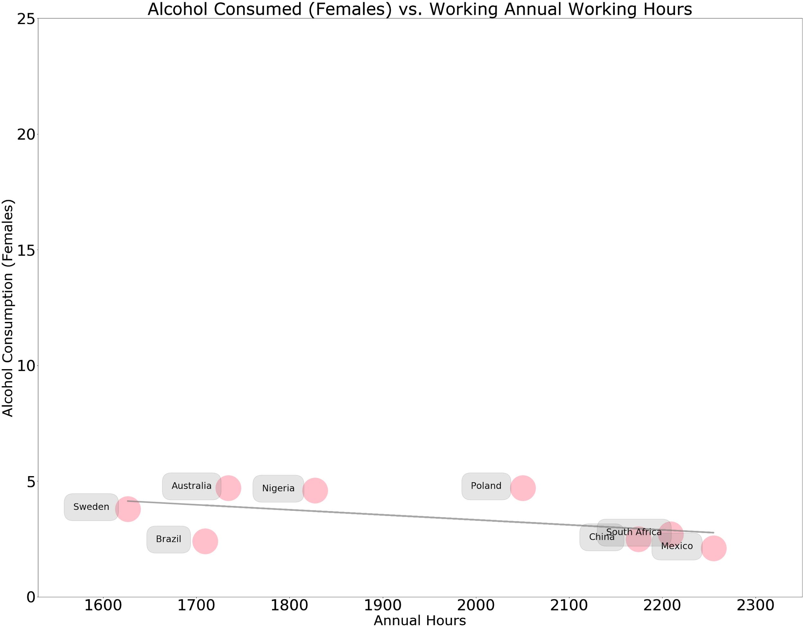
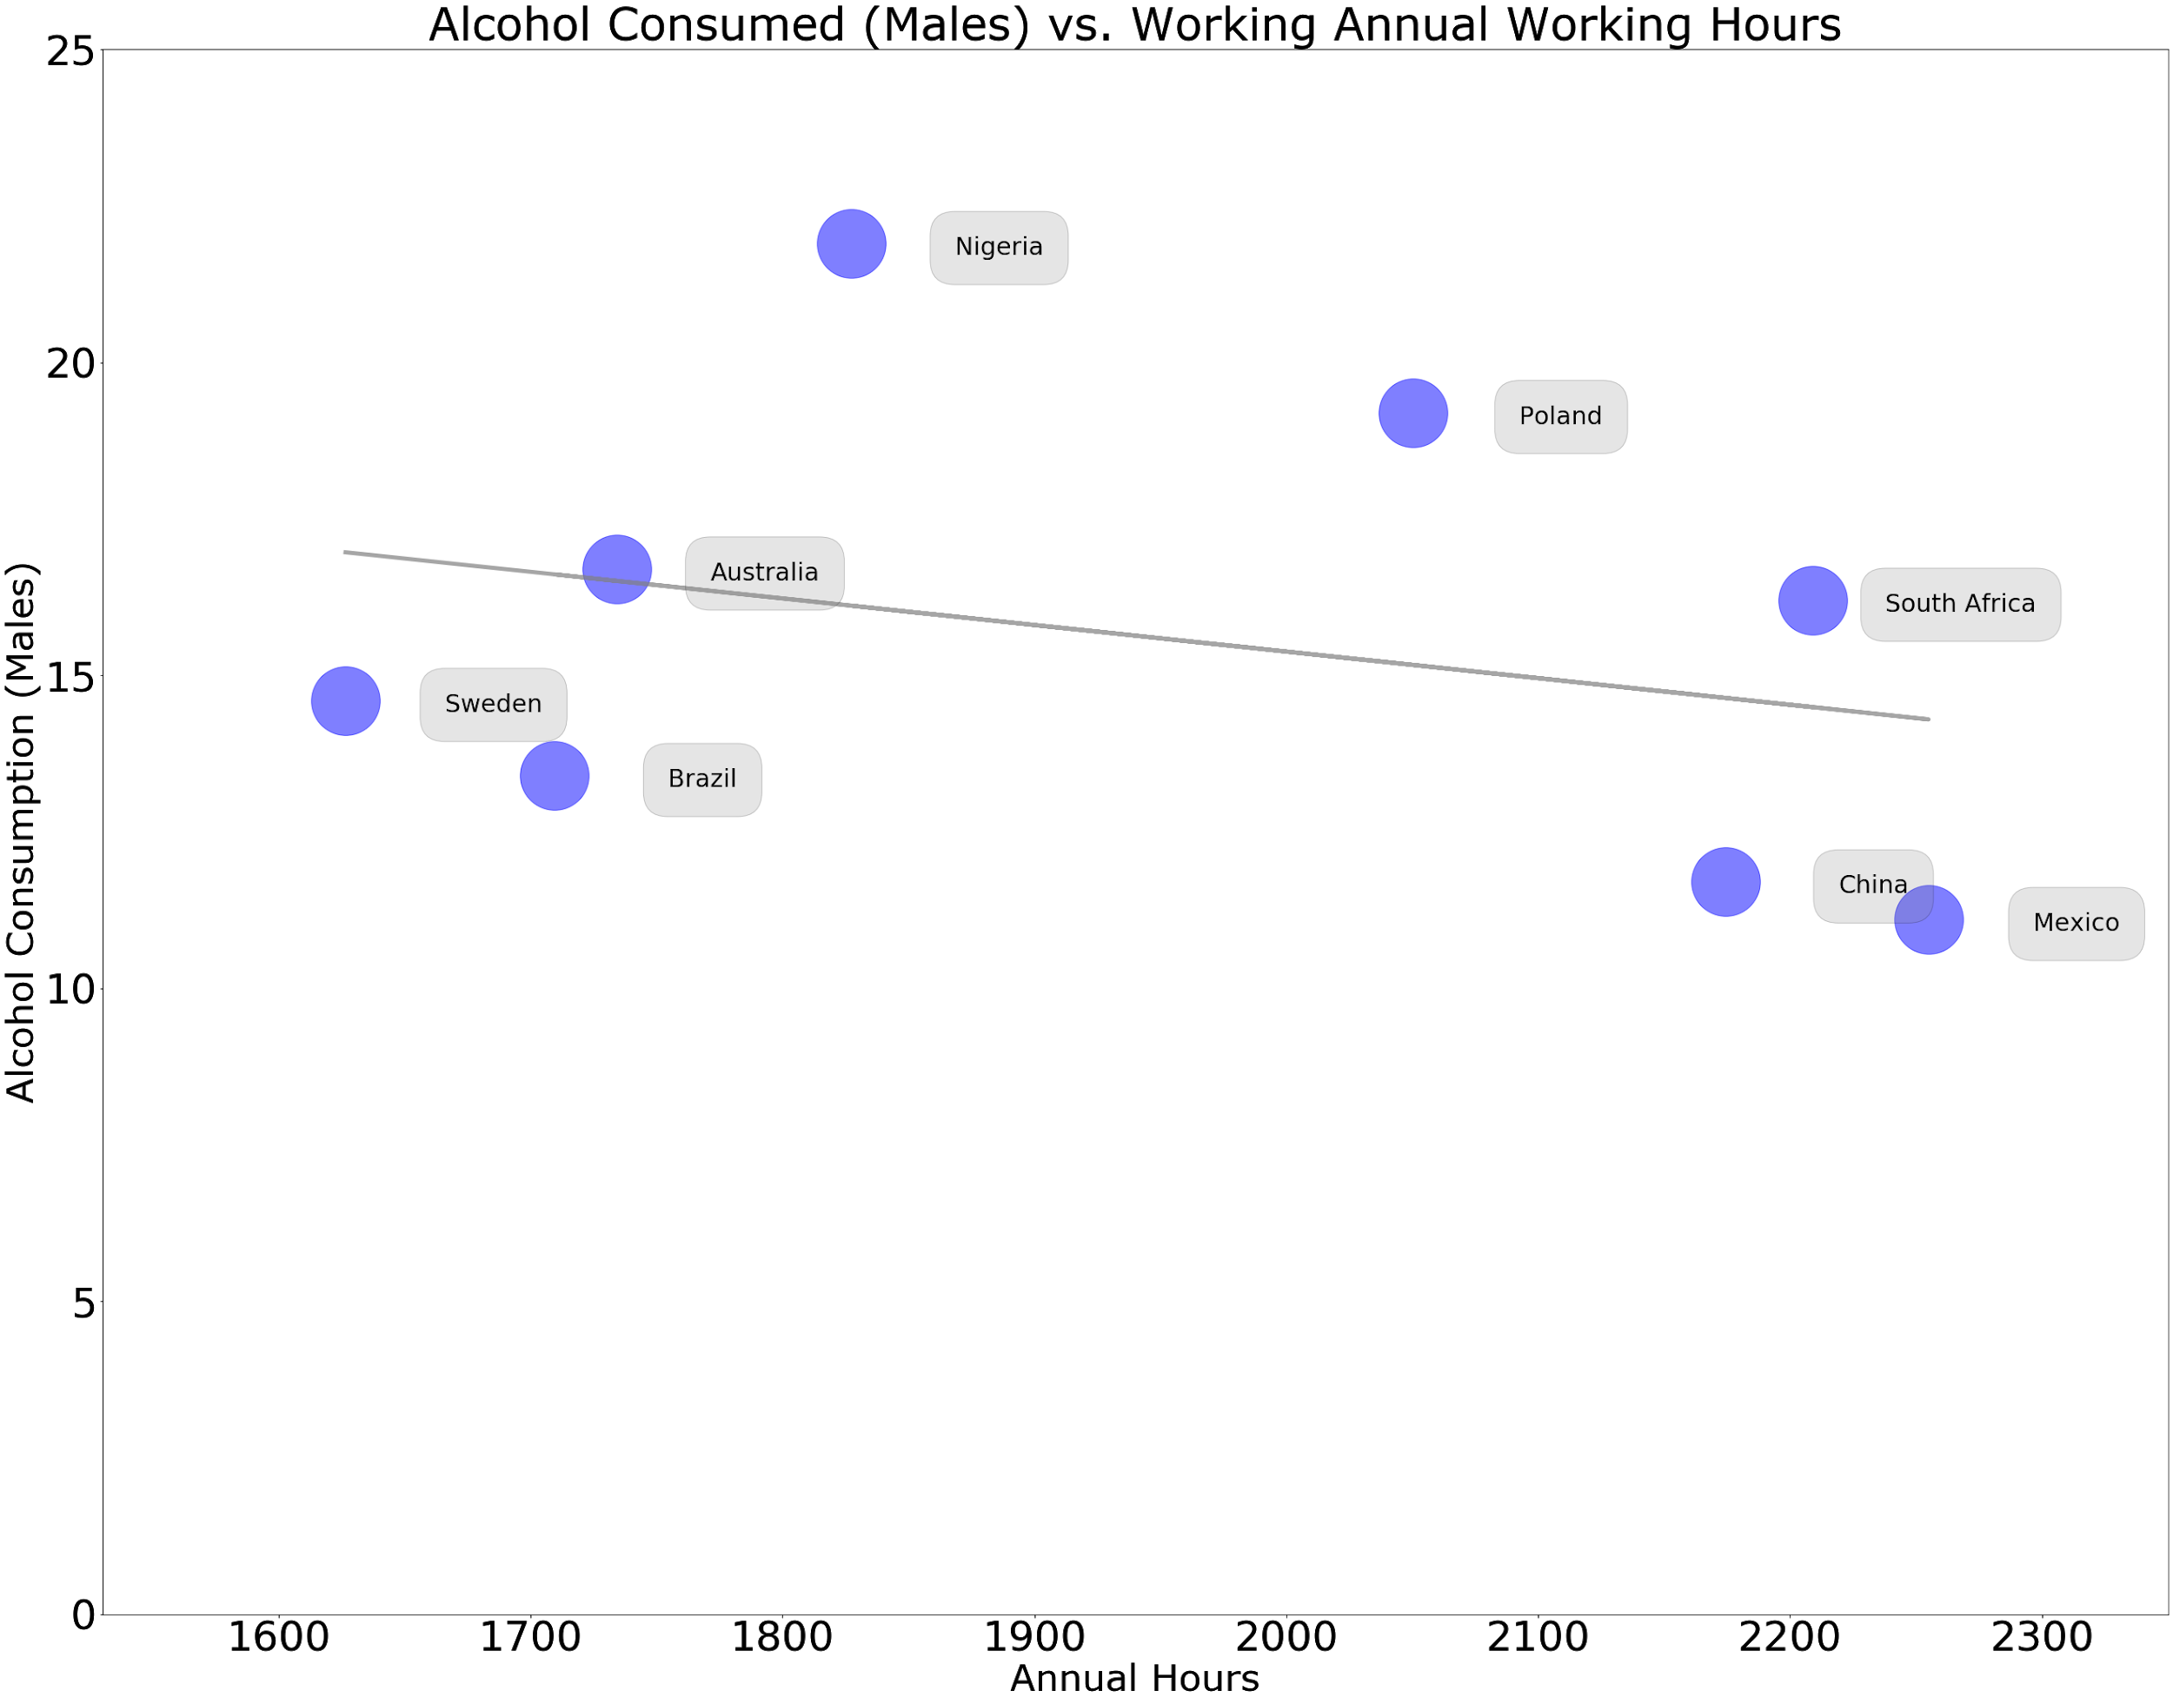
Aim 3: Do nations that work more drink more?
A
B

Slide 18
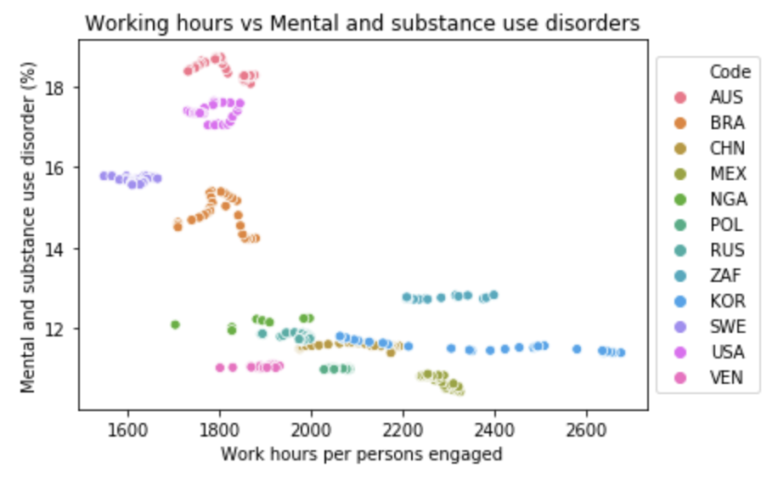
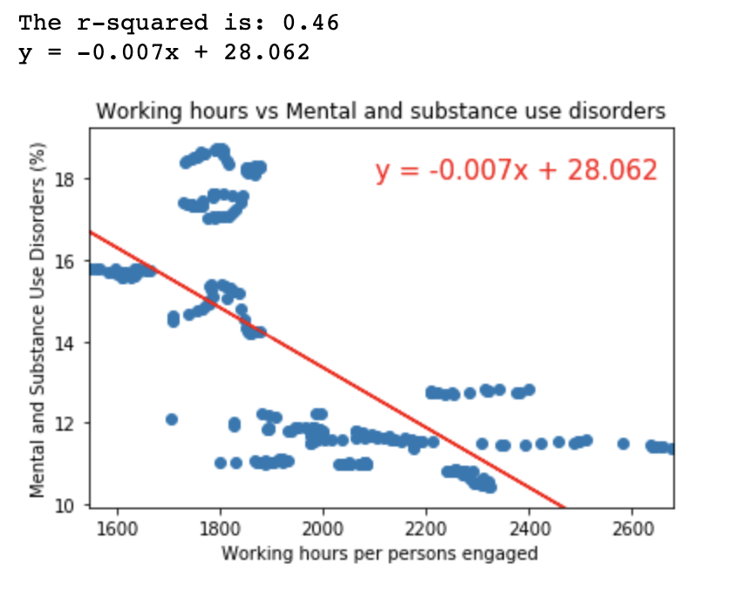
Aim 3: Mental disorders and substance abuse
A
B
Notes:
Working hours and mental health/substance use disorders have a negative relationship
More hours = less mental health disorders
Was surprised about the relationship

Slide 19
Aims
Aim 1: Have annual working hours changed over time?
Primarily trending downwards
Aim 2: What is the relationship of working hours to happiness?
Changes in happiness over time is very nation dependant.
People who work more tend to be less happy!
Aim 3: Do people who work more have more substance abuse issues? Drink more?
Drinking: hard to say. Data limitations and other factors involved.
Mental and substance use disorders: moderate correlation. Confounding factors.
Aim 4: What is the relationship between GDP and happiness?

Slide 20
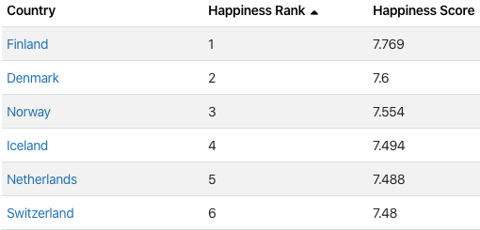
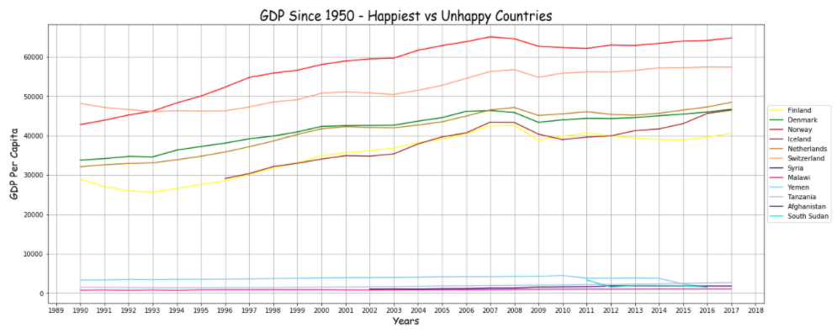
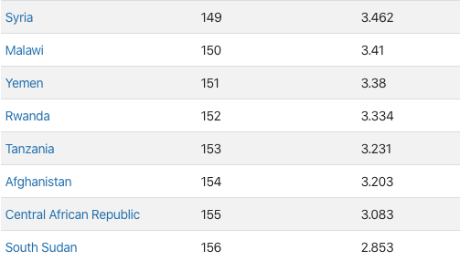
Aim 4: Relationship between GDP growth and happiness
Countries with GDP growth over time show a higher happiness score
Countries with a declining GDP have a lower happiness score

Slide 21
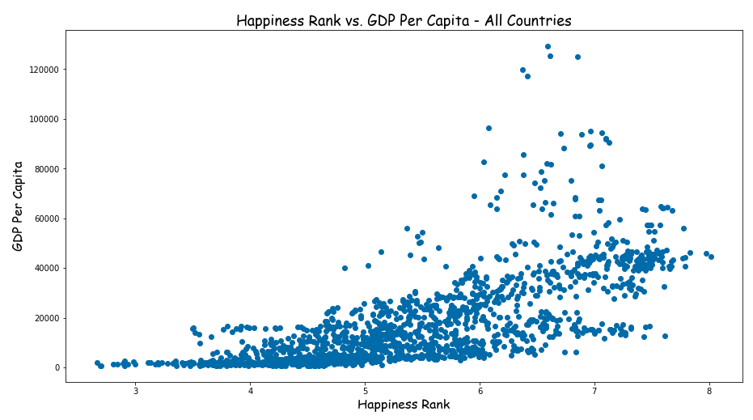
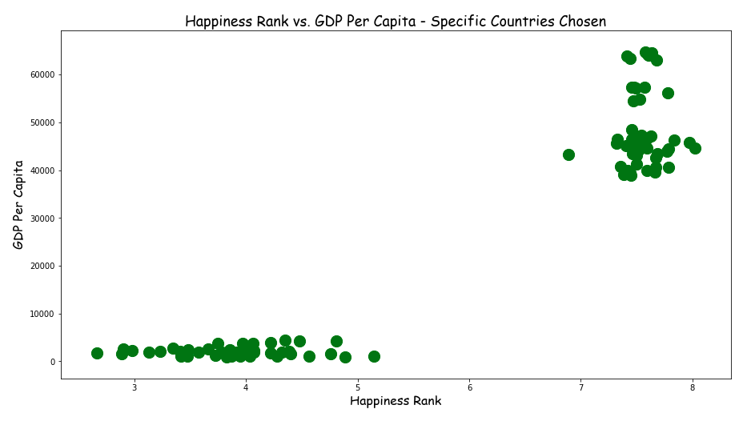
Aim 4: GDP growth and happiness
Higher GDP for all countries also shows increase in happiness rank
A
B

Slide 22
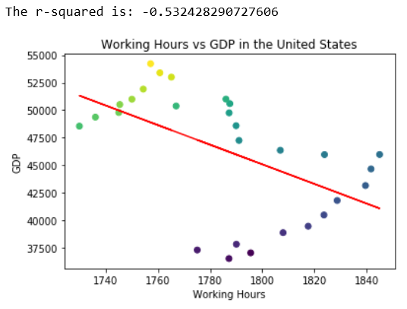
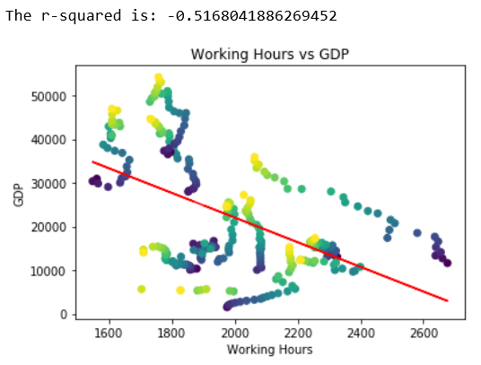
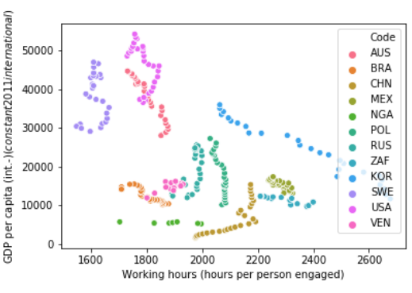
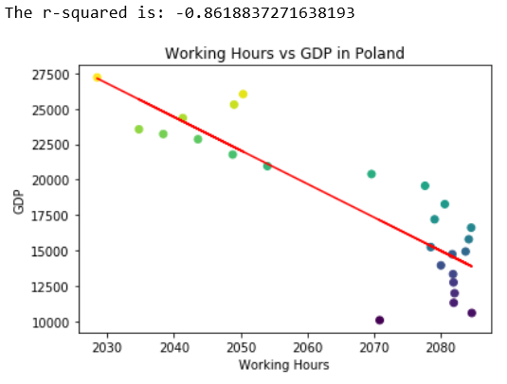
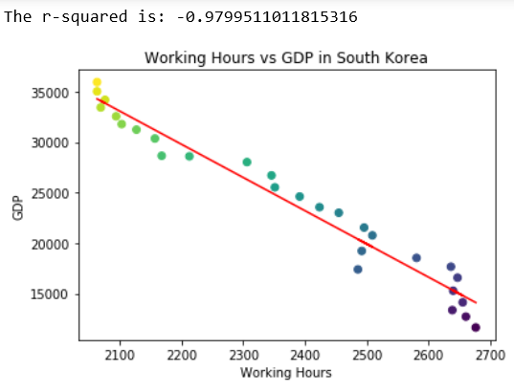
Aim 4: Working hours relationship to GDP
B
C
A
D
E

Slide 23
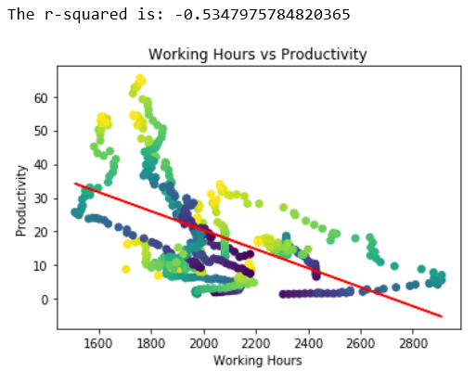
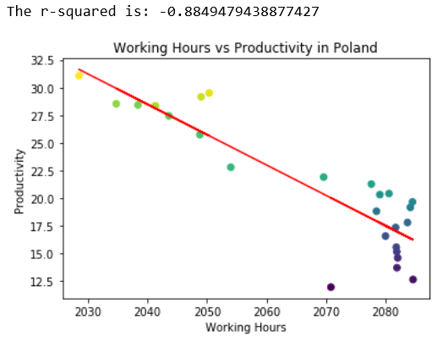
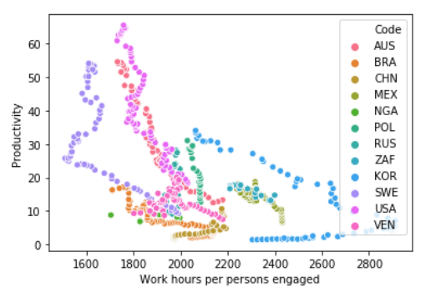
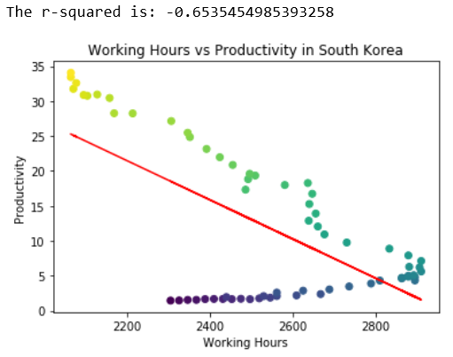
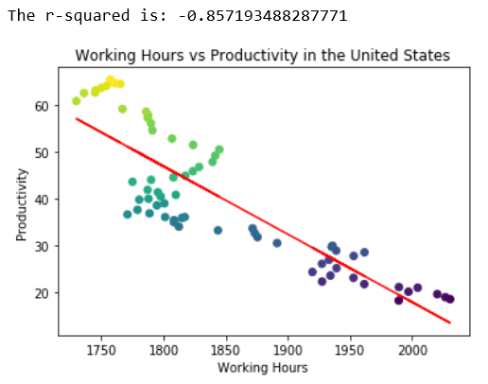
Aim 4: Working hours relationship to productivity
B
C
A
D
E

Slide 24
Aims
Aim 1: Have annual working hours changed over time?
Primarily trending downwards
Aim 2: What is the relationship of working hours to happiness?
Changes in happiness over time is very nation dependant.
People who work more tend to be less happy!
Aim 3: Do people who work more have more substance abuse issues? Drink more?
Drinking: hard to say. Data limitations and other factors involved.
Mental and substance use disorders: moderate correlation. Confounding factors.
Aim 4: What is the relationship between GDP and happiness
Countries with higher trending GDP over time show happiness scores also increase
Countries with higher GDP tend to work less, but very country specific
Countries with higher productivity also tend to work less

Slide 25
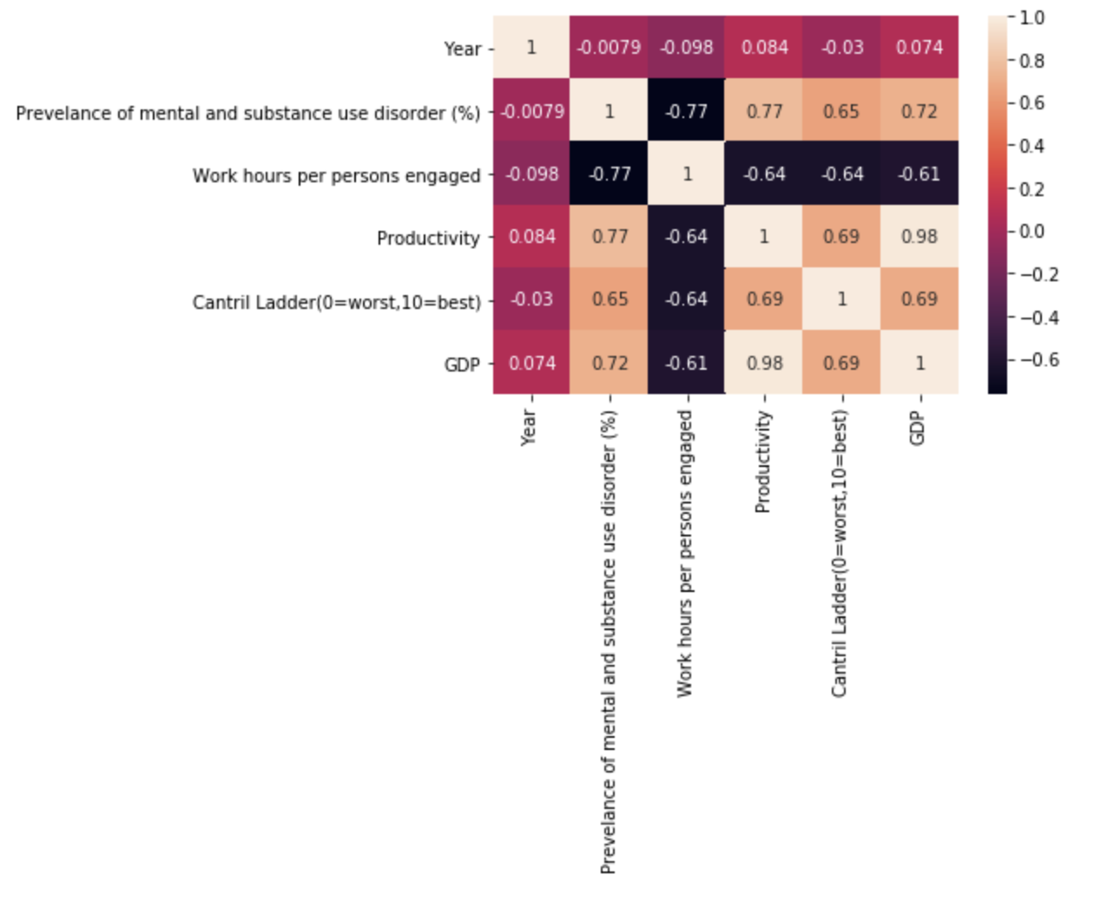
Correlation Matrix
Notes:
Merged all data sets to make correlation matrix
Used to understand our data as a whole

Slide 26
Post Mortem
Challenges
We had major issues merging branches
Paul and Gretel helped us work this out
Limitations
Data availability
Project scope/personal skill limitations
Data source limitations (cantril ladder, productivity)
Correlation != causation
Future aims/questions we want to answer
Different economic measures, ex: imports/exports
Health and stress as consequences of working hours
Representativeness of our selected countries to the world

Slide 27
Questions?

Slide 28
Presentation Requirements ( Delete slide for presentation)
Be at least 8-10 min. lon
Describe the core message or hypothesis for your project.
Describe the questions you and your group found interesting, and what motivated you to answer them
Summarize where and how you found the data you used to answer these questions
Describe the data exploration and cleanup process (accompanied by your Jupyter Notebook)
Describe the analysis process (accompanied by your Jupyter Notebook)
Summarize your conclusions. This should include a numerical summary (i.e., what data did your analysis yield), as well as visualizations of that summary (plots of the final analysis data)
Discuss the implications of your findings. This is where you get to have an open-ended discussion about what your findings "mean"
Tell a good story! Storytelling through data analysis is no different than in literature. Find your narrative and use your analysis and visualization skills to highlight conflict and resolution in your data.

Slide 29
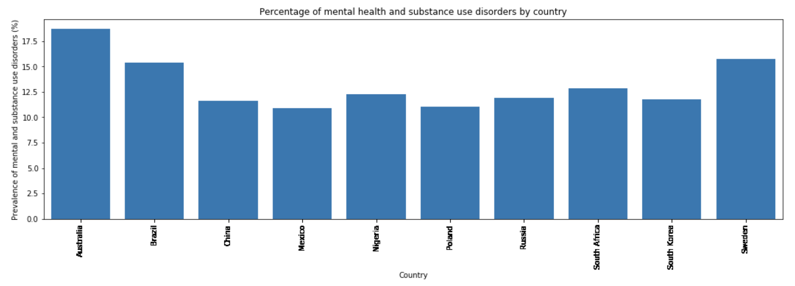

Slide 30
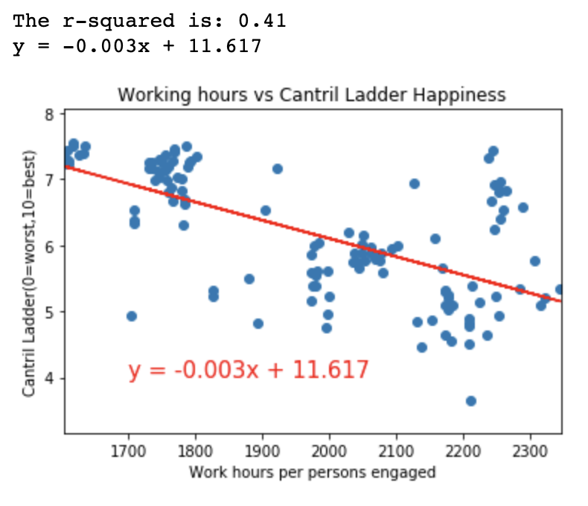

Slide 31
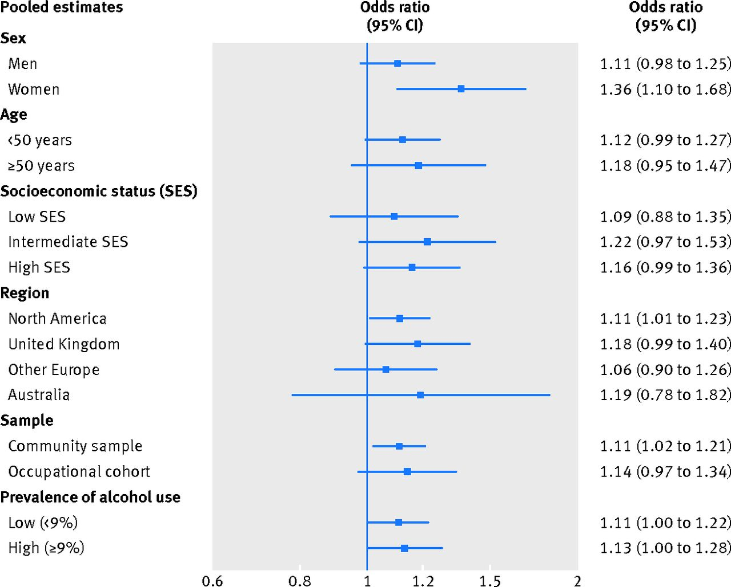
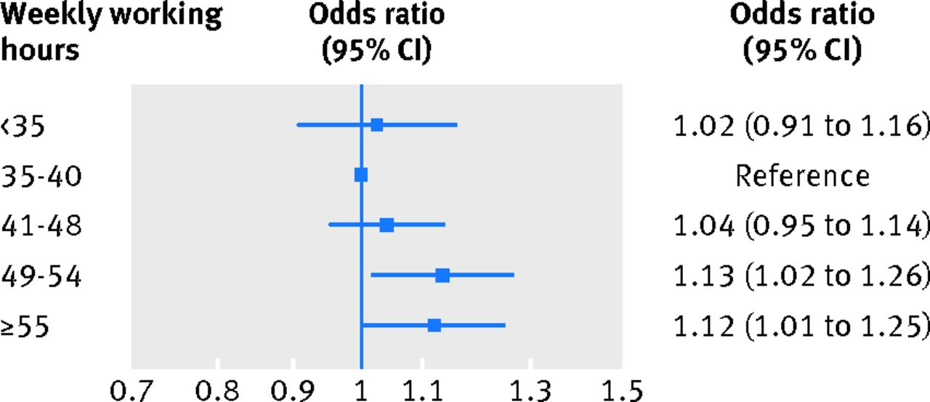
Does working more make us drink our feelings away?
Long working hours and alcohol use: systematic review and meta-analysis of published studies and unpublished individual participant data
Virtanen et. al.
BMJ 2015; 350 doi: https://doi.org/10.1136/bmj.g7772 (Published 13 January 2015)
Notes:
This systematic review and meta-analysis of 63 studies provides comprehensive evidence of an association between long working hours and alcohol use.
Long working hours were associated with 1.11-fold likelihood of higher levels of alcohol use in the cross sectional analysis of 333 693 participants from 14 countries.
Bias: “work hard play hard” culture with positive attitudes towards heavy alcohol use, type A work hard

Slide 32
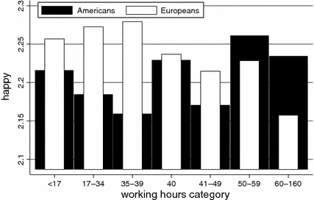
Europeans Work to Live and Americans Live to Work (Who is Happy to Work More: Americans or Europeans?)
Adam Okulicz-Kozaryn
Journal of Happiness Studies volume 12, pages 225–243(2011)

Slide 33
